Slide 1

Design and Implementation of AN ELECTRONIC ELECTORAL SYSTEM FOR ELECAM
By: YENSEH CURTIS KUTI
Yaounde International Business school, department of Software Engineering
Supervisor: Mr. Tekoh Palma Achu

Slide 2
01
02
Introduction
Literature Review
05
04
03
Results
Methodology
Context
Motivational Example
Problem Statement
Objectives
Review of existing systems
Conclusion
Contributions
Difficulties Encountered
Recommendations for further studies
Conclusion
Demo of Application
Tools & Technologies used
Architecture
UML

Slide 3


Introduction
This research paper titled “ Design and Implementation of an Electronic Electoral System for ELECAM” investigates how the current system works and how the proposed system will help ELECAM for better transparency.

Slide 4

MOTIVATIONAL EXAMPLE
On 22 October 2018, incumbent Paul Biya was declared winner with a score of 71% despite all the controversies that surrounded the elections (reliefweb, 2018)

Slide 5

Problem Statement
Due to the criticisms such as: low transparency, fairness, effectiveness, it is evident that the current manual system really needs to be redesigned and improved.

Slide 6

Problems of the Current system.
Time consumption,
Resource consumption,
Low transparency & trust,
Low fairness and effectiveness,
Tendencies of fraud and violence.

Slide 7

Research Question/Objectives
1
Research Objective
To develop an interactive, usable, and secured electronic electoral system for ELECAM.
2
General Question
Will developing an electronic electoral system be an effective method for managing elections for ELECAM?”

Slide 8

Literature Review
Victoria University Kampala e-voting Application (VU Elections)
USA ELECTORAL SYSTEM
University of Kwame Nkruma voting Portal

Slide 9






Methodology
Incremental SDLC Model
Requirement Analysis
Design
Coding
Implementation/Testing

Slide 11
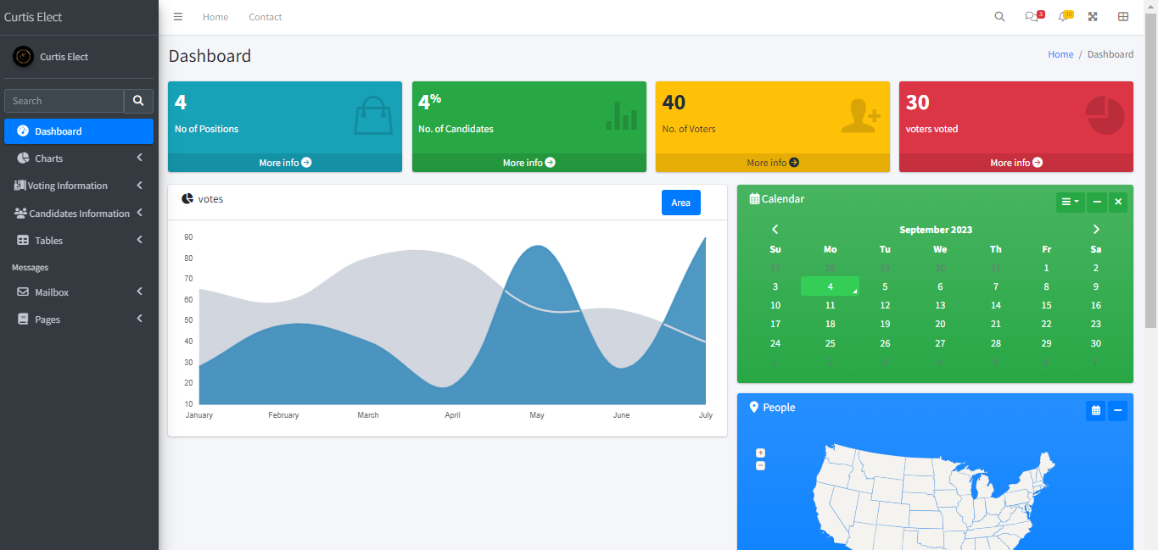
Design
Admin Dashboard Page

Slide 12
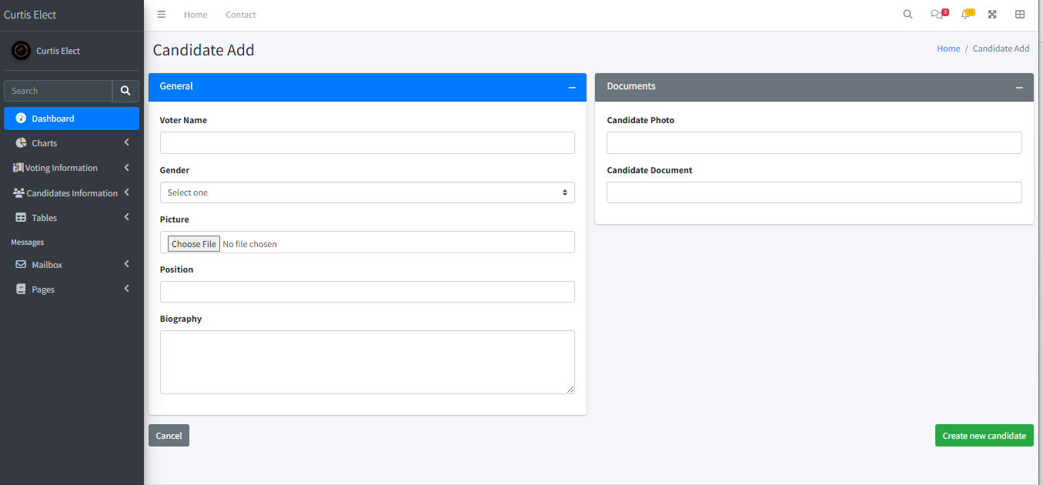
Design
Add Candidate Form

Slide 13
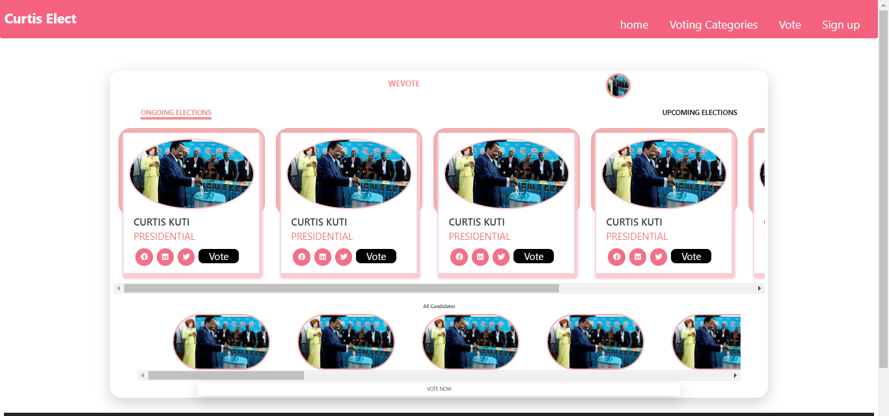
Design
Voting Timeline Page

Slide 14
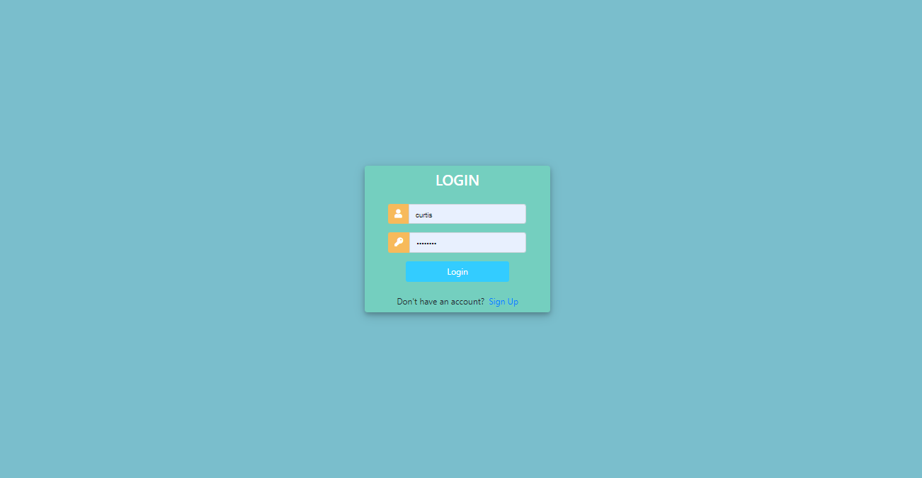
Design
Login page

Slide 15
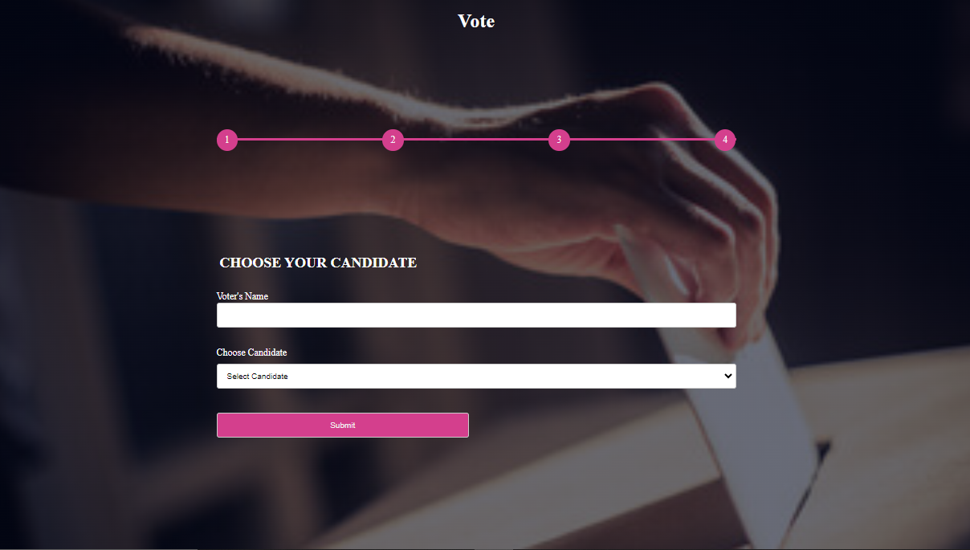
Design
Voting Form

Slide 16

Testing/Demo
The system was put through its paces at both the unit and integration levels.
The Video in the next slide shows how the system works.

Slide 17

Conclusion
Research question
01
How have the questions been answered?
02
Limitations to the work.
Future research and recommendations.
03
04

Slide 18
THANKS VERY MUCH FOR YOUR KEEN ATTENTION.
ANY QUESTIONS PLEASE??

